Slide 1

Data Structures (15B11CI311) Odd Semester 2021
3rd Semester , Computer Science and Engineering
Jaypee Institute Of Information Technology (JIIT), Noida

Slide 2
Lecture: 24
Topics to be covered:
Introduction to BST
Operations on BST

Slide 3
Binary Search Tree
A Binary Search Tree is a binary tree with the following properties:
The left sub-tree nodes contain less value than the root node value.
The right sub-tree nodes contain greater or equal value to the root node value.
Each sub-tree is itself a binary search tree.
It is used to search the data efficiently along with insertion and deletion.

Slide 4
Binary Search Tree
Some of the Valid BST

Slide 5
BST Operations
Traversals:
Like binary tree Inorder, Preorder and post order traversals
Searches
Insertion
Deletion

Slide 6
Search a node in a BST
Smallest node
Largest node
A requested node

Slide 7
Find the smallest node
Source: Data Structures A Pseudocode Approach with C, Second Edition by Richard F. Gilberg Behrouz A. Forouzan

Slide 8
Find the Largest node
Source: Data Structures A Pseudocode Approach with C, Second Edition by Richard F. Gilberg Behrouz A. Forouzan

Slide 9
Find the Requested node
Source: Data Structures A Pseudocode Approach with C, Second Edition by Richard F. Gilberg Behrouz A. Forouzan

Slide 10
Searching
Searching in a BST has O(h) worst-case runtime complexity, where h is the height of the tree.
Minimum number of levels in a n node BST: O(log n)
It takes at least O(log n) comparisons to find a particular node.
In worst case: O(n)
When the tree is right or left skewed

Slide 11
Insert into BST
To insert new node, follow the branches to an empty sub-tree and then insert the new node.
Insertion takes place at a leaf or a leaf like node: a node that has only one null subtree
Source: Data Structures A Pseudocode Approach with C, Second Edition by Richard F. Gilberg Behrouz A. Forouzan

Slide 12
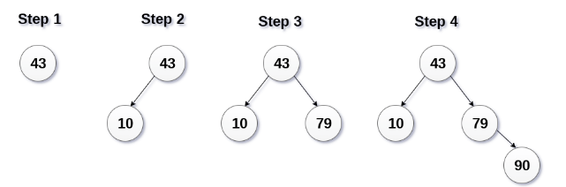
Insert into BST
Elements to be inserted:
43, 10, 79, 90, 12, 54, 11, 9, 50
Source: https://www.javatpoint.com/binary-search-tree

Slide 13
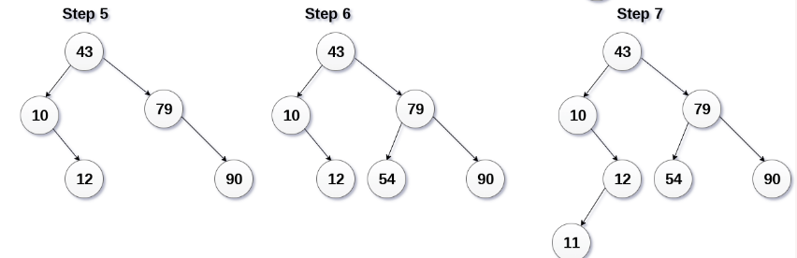
Insert into BST
Elements to be inserted:
43, 10, 79, 90, 12, 54, 11, 9, 50
Source: https://www.javatpoint.com/binary-search-tree

Slide 14
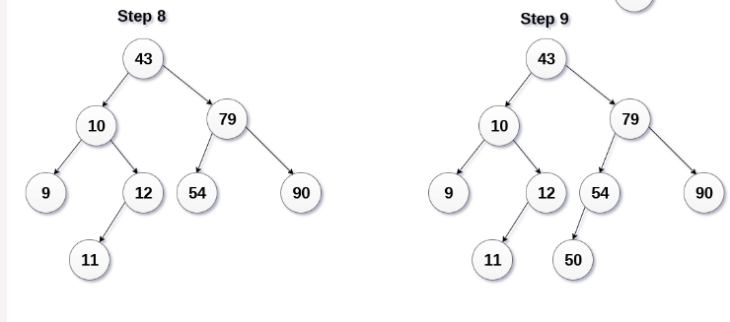
Insert into BST
Elements to be inserted:
43, 10, 79, 90, 12, 54, 11, 9, 50
Source: https://www.javatpoint.com/binary-search-tree

Slide 15
Insert into BST
Source: Data Structures A Pseudocode Approach with C, Second Edition by Richard F. Gilberg Behrouz A. Forouzan

Slide 16
Deletion in BST
Following are the cases to delete the node from a BST
The node which is to be deleted is not available in the tree;
The node which is to be deleted is a leaf node
Delete the node
The node which is to be deleted has only one child
Delete the node and attach the subtree to the deleted node’s parent
The node which is to be deleted has two children
Find the largest node in the deleted node’s left sub tree and move its data to replace the deleted node’s data. OR
Find the smallest node on the deleted node’s right sub tree and move its data to replace the deleted node’s data.
Either of these moves preserves the integrity of the binary search tree.

Slide 17
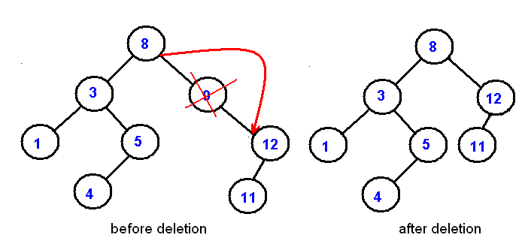
Deletion in BST

Slide 18
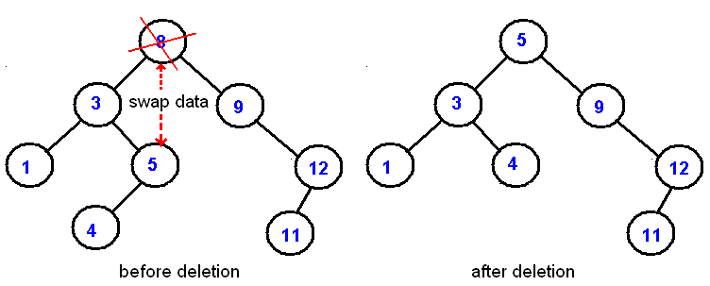
Deletion in BST

Slide 19
Deletion in BST
Source: Data Structures A Pseudocode Approach with C, Second Edition by Richard F. Gilberg Behrouz A. Forouzan

Slide 20
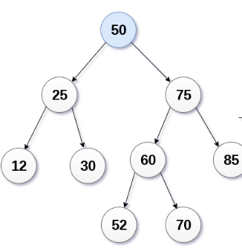
Question 1
Delete 85, 12, 50

Slide 21
Question 2
There are 1-100 keys in BST. We need to Search for 55. Which of the following sequence can not be the seq. of nodes examined?
10,75,64,43,60,55,55
90,12,68,34,62,45,55
9,85,47,68,43,57,55
79,14,72,56,16,53,55

Slide 22
Question 3
Suppose the numbers 7, 5, 1, 8, 3, 6, 0, 9, 4, 2 are inserted in that order into an initially empty binary search tree. The binary search tree uses the usual ordering on natural numbers. What is the in-order traversal sequence of the resultant tree?

Slide 23
Question 4
// A BST node
struct node {
int data;
struct node *left, *right;
};
int count = 0;
void print(struct node *root, int k)
{
if (root != NULL && count <= k)
{
print(root->right, k);
count++;
if (count == k)
printf("%d ", root->data);
print(root->left, k);
}
}
Consider the following code snippet in C. The function print() receives root of a Binary Search Tree (BST) and a positive integer k as arguments.
What is the output of print(root, 3) where root represent root of the following BST.
15
/ \
10 20
/ \ / \
8 12 16 25

Slide 24
References
Cormen, Thomas H.; Leiserson, Charles E.; Rivest, Ronald L.; Stein, Clifford (2009) [1990]
Introduction to Algorithms (3rd ed.). MIT Press and McGraw-Hill. ISBN 0-262-03384-4. 1320 pp.
Adam Drozdek, Data Structures and Algorithms in C++ (2nd Edition), 2001
Data Structures A Pseudocode Approach with C, Second Edition by Richard F. Gilberg Behrouz A. Forouzan
https://www.geeksforgeeks.org/iterative-postorder-traversal/
https://www.tutorialspoint.com/cplusplus-program-to-perform-inorder-non-recursive-traversal-of-a-given-binary-tree
https://www.tutorialspoint.com/cplusplus-program-to-perform-preorder-non-recursive-traversal-of-a-given-binary-tree
[1]https://www.cs.cmu.edu/~adamchik/15-121/lectures/Trees/trees.html
[2]https://www.javatpoint.com/binary-search-tree
[3] http://web.eecs.umich.edu/~akamil/teaching/su02/080802.ppt

